Slide 1
eGIS Team Updates
December 2022

Slide 2
LARIAC (An)
The application for USGS BAA grant for LiDAR acquisition (over $592K) has been accepted and recommended for funding on December 6, 2022. In addition, the GIO has secured additional $300K funding commitment from California Natural Resource Agency and another $20K from USGS Pasadena Earthquake Office.
Amendment No. 7 to extend the current contract with Pictometry for acquisition of digital aerial data for LARIAC 7 has been executed. Vendor is working on flight plans to start capturing as early as January 2023.
eGIS staff is working with ISD Contracting Division to prepare the Street-Level Data RFP to acquire high resolution 360-degree street-level imagery and LiDAR data of various areas within the County of Los Angeles

Slide 3
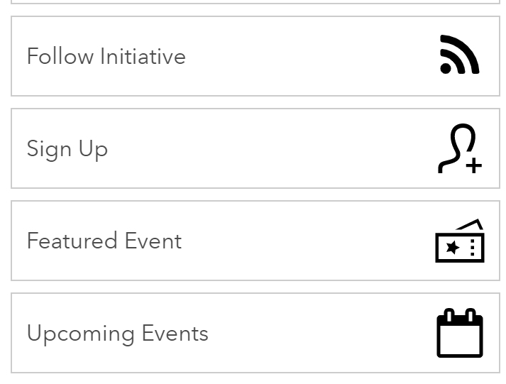
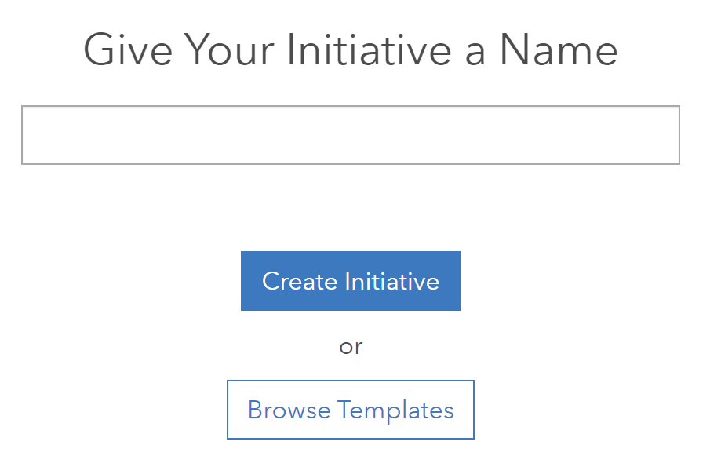
ArcGIS Online (Shannon)
LA County now has Hub Premium
New Layout elements
New Admin settings
Initiative templates: premade or option to create your own
CEO-CIO Open Data Project
New custom user roles (example: Open Data Coordinator) and member categories coming soon
For your reading enjoyment
Esri’s ArcGIS Online 2022 Year in Review
New Enhancements to ACS data in ArcGIS Online
Interesting article about the Search widget
2022 Paper Globe Ornament – an annual tradition!

Slide 4
Data (Rob)
Thank you to the 2022 GIS Data Committee! Last meeting of the year last week
Agendas and minutes from all meetings are available on the eGIS Central page and Data Committee Teams folder
We'll release the schedule for 2023 meetings in early January – please continue to reach out with any topics or discussion items (rgraham@isd.lacounty.gov or egis@isd.lacounty.gov)

Slide 5
Demography & Census (Victor)
To collaborate with the DPW to update the CSA data for recent “Tesoro Del Valle” annexation to the city of Santa Clarita to match with DPW updated city boundaries.
To update Census tract boundary along shoreline/coastal areas to match with DPW updated city boundaries.
Working on County administration data of Voter geocoded file and Assessor parcel geocoded file to support the annual population estimation.
ACS 2017-2021 5-Year Estimate Data was released on December 8, 2022.

Slide 6
Infrastructure Status & Updates (Junior)
Spatial Database Engine Geodatabases (GDBs) upgrade:
eGIS_Transportation and eGIS_Basemaps_Grids GDBs have been upgraded to version 10.7.1.
Access Control Lists clean up for GIS DMZ servers
Working with ISD Network Security team to validate ports connections and clean up in-active ports that were opened
The team is in the process of upgrading eGIS Windows Server 2012 to Windows Server 2019.
The team is working with the DPSS GIS team to deploy the DPSS ArcGIS Enterprise Portal.
We are engaging with Esri Professional Services to implement tools for early detection of potential issues and to review system configuration, workflows, error logs, system administration, and operation.

Slide 7
CAMS (Rachel)
Data Quality Management Portal – Update(s)
Live and Functional – Request Access
Quality Validations
Change Detection*
New training available for Cities
CAMS Delegated Authority APPROVED
Delegating authority for ISD to maintain a coordinated repository, established by board motion, and providing the ability for ISD to enter into MOU agreements with jurisdictions, can centralize the utilization, dissemination, and communication of authoritative addresses within the County. LINK
Schedule for 2023

