Slide 1
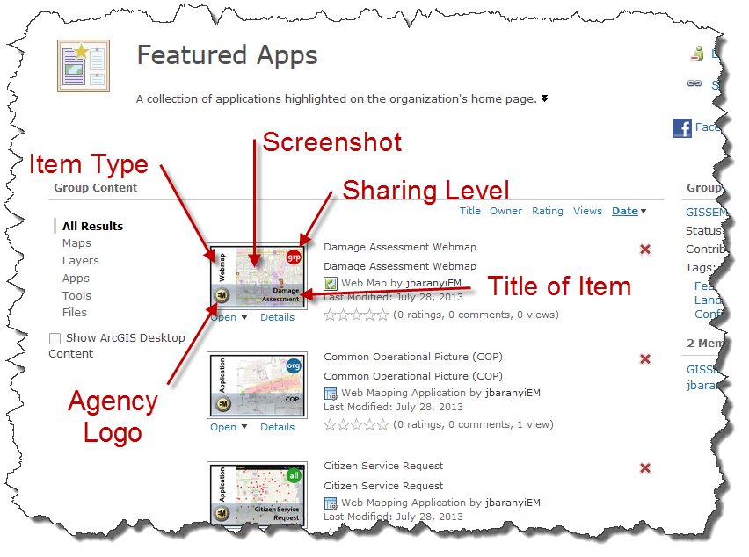
Instructions
The thumbnail boxes have been pre-sized for your use. Simply change the Title, Logo, Screenshot (if necessary), and Sharing.
Add your image/screenshot of your item to the slide & replace the current image in the thumbnail with yours (you may need to send it to the front or back)
Next delete the current logo and add your departmental logo
Make sure you indicate the item type, sharing level and title of your item
Use the snipping tool (or another tool) and snip out your thumbnail, save it as a PNG file, open it in Paint mode and make sure it meets the correct size requirement (it not you will need to change it to 200 x 133 pixels)
Log into AGOL and find your item (usually under My Content)
On the details page for your item, just above the item thumbnail, click “Edit Thumbnail,” then add your PNG file (you may need to refresh the page to see your thumbnail)
Common Item Types:
Layer
Shapefile
Service
Web Map
Application
Story Map
Dashboard
Basemap
Form
File GDB
Sharing Level
all
Everyone (Public)
org
LA County Only
grp
Group Private
Examples – Screenshots of Current AGOL Items Owned by Different Departments
Layer: http://lacounty.maps.arcgis.com/home/item.html?id=31f35e95748442afb6302f61a9f19d7d
Application: http://lacounty.maps.arcgis.com/home/item.html?id=c8259b594b34437493e9c0e8ae9fb54e
Web Map: http://lacounty.maps.arcgis.com/home/item.html?id=69c84abf3919423692a7dbfcd99812f2

Slide 2
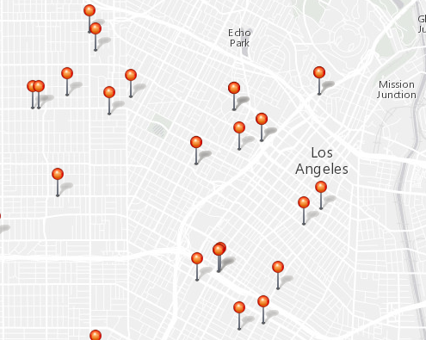
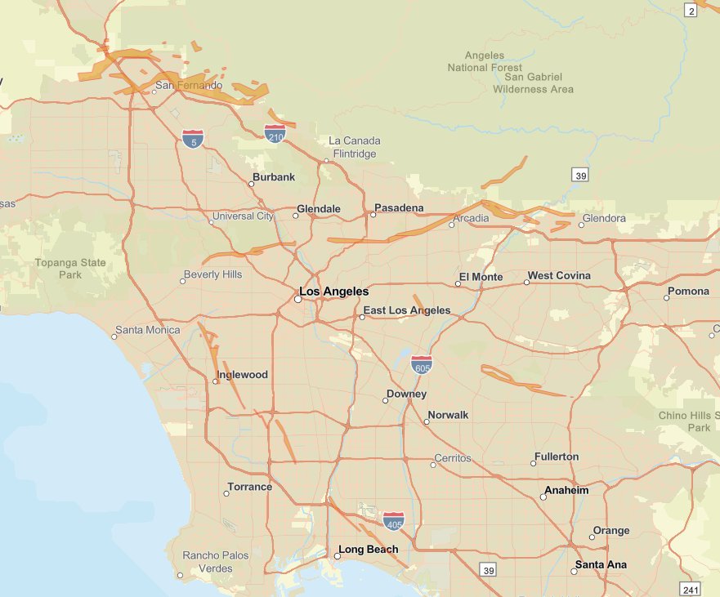
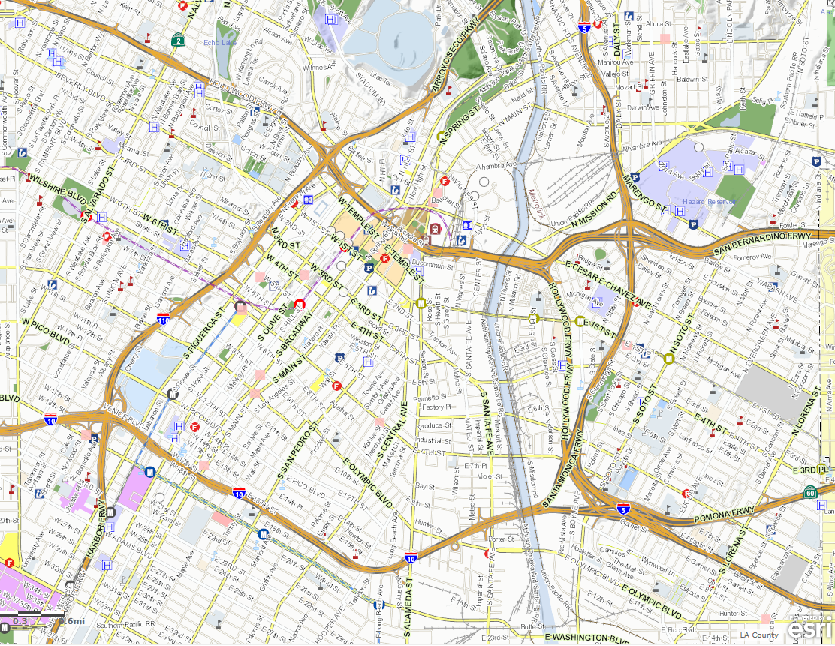
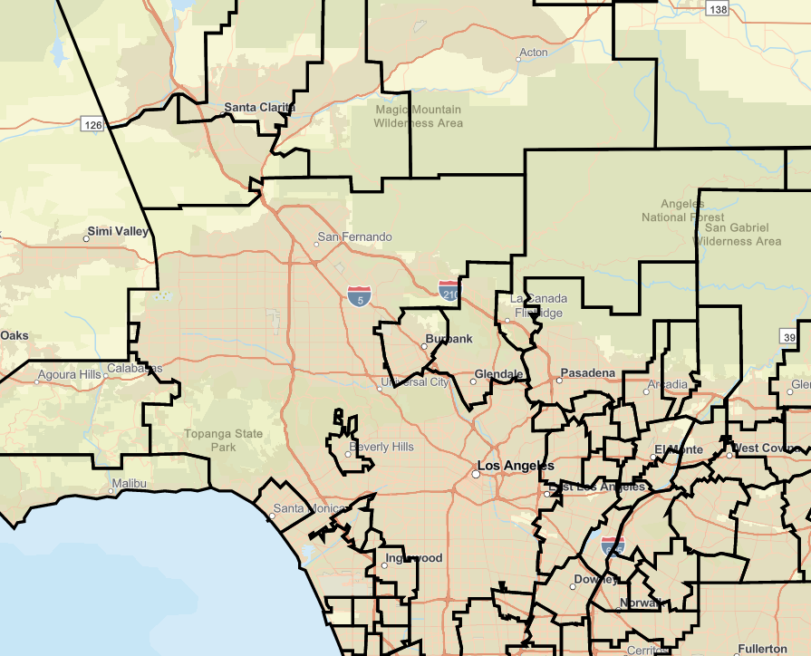
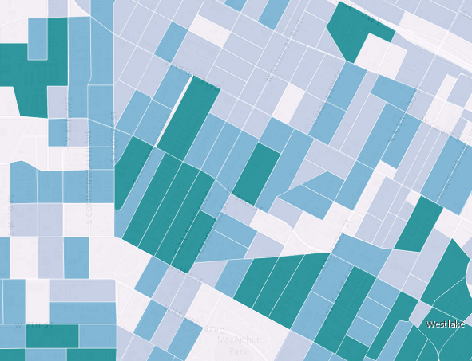
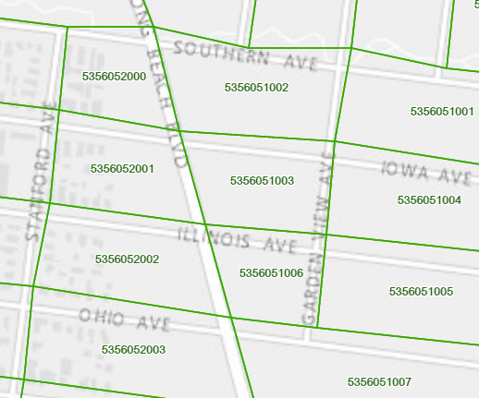
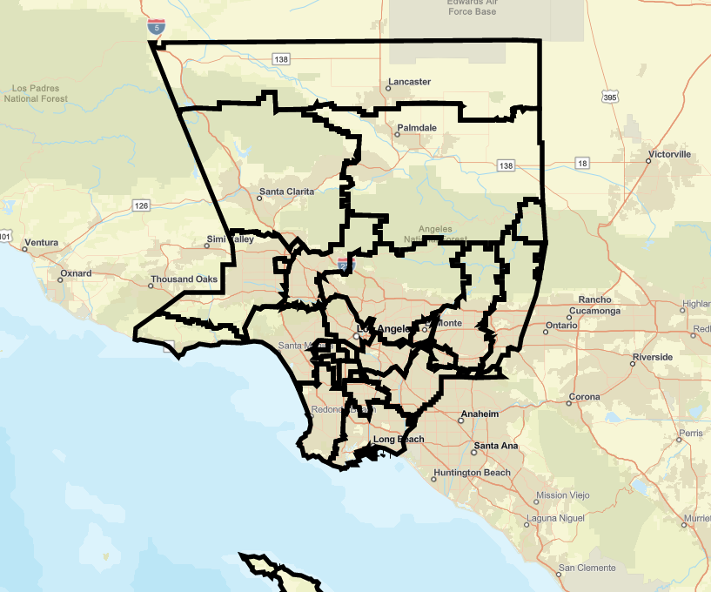
Layer
Point Features
all
org
grp
Layer
Layer
Layer
Title
TITLE
TITLE
Line Features
all
org
grp
Layer
Layer
Layer
TITLE
TITLE
TITLE
Polygon Features
org
grp
all
all
Layer
Layer
Layer
TITLE
TITLE
TITLE

Slide 3
Shapefile
Point Features
all
org
grp
Shapefile
Shapefile
Shapefile
TITLE
TITLE
TITLE
Line Features
all
org
grp
Shapefile
Shapefile
Shapefile
TITLE
TITLE
TITLE
Polygon Features
all
org
grp
Shapefile
Shapefile
Shapefile
TITLE
TITLE
TITLE

Slide 4
Service
Point Features
all
org
grp
Service
Service
Service
TITLE
TITLE
TITLE
Line Features
all
org
grp
Service
Service
Service
TITLE
TITLE
TITLE
Polygon Features
all
org
grp
Service
Service
Service
TITLE
TITLE
TITLE

Slide 5
Service Definition
Point Features
all
org
grp
Service
Definition
Service
Definition
Service
Definition
TITLE
TITLE
TITLE
Line Features
all
org
grp
Service
Definition
Service
Definition
Service
Definition
TITLE
TITLE
TITLE
Polygon Features
all
org
grp
Service
Definition
Service
Definition
Service
Definition
TITLE
TITLE
TITLE

Slide 6
Web Map
Point Features
all
org
grp
Web Map
Web Map
Web Map
TITLE
TITLE
TITLE
Line Features
all
org
grp
Web Map
Web Map
Web Map
TITLE
TITLE
TITLE
Polygon Features
all
org
grp
Web Map
Web Map
Web Map
TITLE
TITLE
TITLE

Slide 7
Web App
Point Features
all
org
grp
Web App
Web App
Web App
TITLE
TITLE
TITLE
Line Features
all
org
grp
Web App
Web App
Web App
TITLE
TITLE
TITLE
Polygon Features
all
org
grp
Web App
Web App
Web App
TITLE
TITLE
TITLE

Slide 8
StoryMap
Point Features
all
org
grp
StoryMap
StoryMap
StoryMap
TITLE
TITLE
TITLE
Line Features
all
org
grp
StoryMap
StoryMap
StoryMap
TITLE
TITLE
TITLE
Polygon Features
all
org
grp
StoryMap
StoryMap
StoryMap
TITLE
TITLE
TITLE

Slide 9
Dashboard
Point Features
all
org
grp
Dashboard
Dashboard
Dashboard
TITLE
TITLE
TITLE
Line Features
all
org
grp
Dashboard
Dashboard
Dashboard
TITLE
TITLE
TITLE
Polygon Features
all
org
grp
Dashboard
Dashboard
Dashboard
TITLE
TITLE
TITLE

Slide 10
Basemap
Point Features
all
org
grp
Basemap
Basemap
Basemap
TITLE
TITLE
TITLE
Line Features
all
org
grp
Basemap
Basemap
Basemap
TITLE
TITLE
TITLE
Polygon Features
all
org
grp
Basemap
Basemap
Basemap
TITLE
TITLE
TITLE

Slide 11
Form
Point Features
all
org
grp
Form
Form
Form
TITLE
TITLE
TITLE
Line Features
all
org
grp
Form
Form
Form
Title
TITLE
TITLE
Polygon Features
all
org
grp
Form
Form
Form
TITLE
TITLE
TITLE

Slide 12
File GDB
Point Features
all
org
grp
File GDB
File GDB
File GDB
TITLE
TITLE
TITLE
Line Features
all
org
grp
File GDB
File GDB
File GDB
TITLE
TITLE
TITLE
Polygon Features
all
org
grp
File GDB
File GDB
File GDB
TITLE
TITLE
TITLE

